Slide 1


AMERICANA LAST MILE DELIVERY PLATFORM (Technical Design)
RESTAURANT DIVISION
GREAT PEOPLE, GREAT
FOOD, GREAT COMPANY

Slide 2
ALMP Platform Introduction and Vision

Slide 3
Americana Last Mile Platform – Introduction and Vision Statement
List of Americana Last Mile Documentation on product introduction and vision statement
Americana Last Mile Delivery Platform – High Level Business Case (Shared on E-mail)
Cost and Budget with – Americana Last Mile Delivery Platform (Discussed with Hakki and will share)

Slide 4
ALMP Application Design

Slide 5
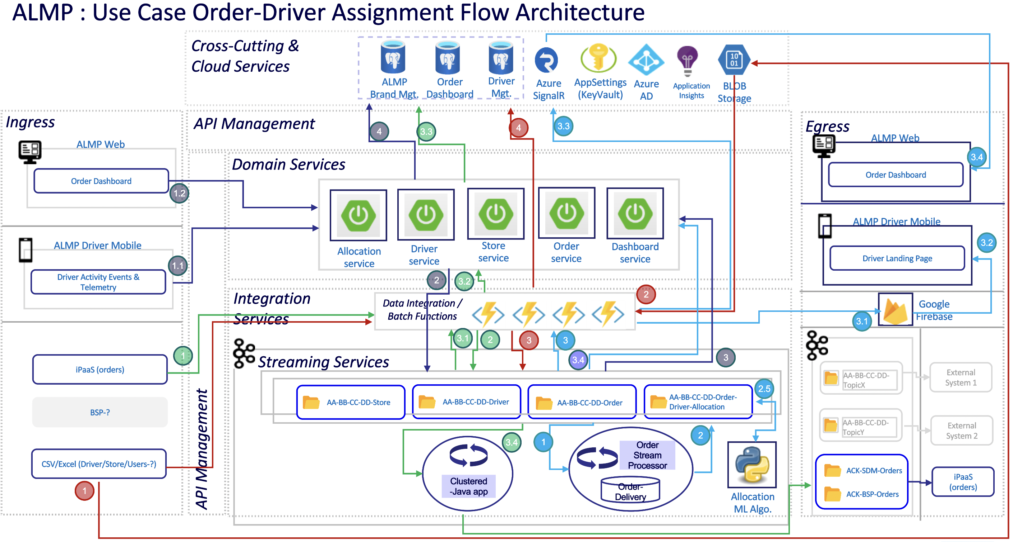

Slide 6
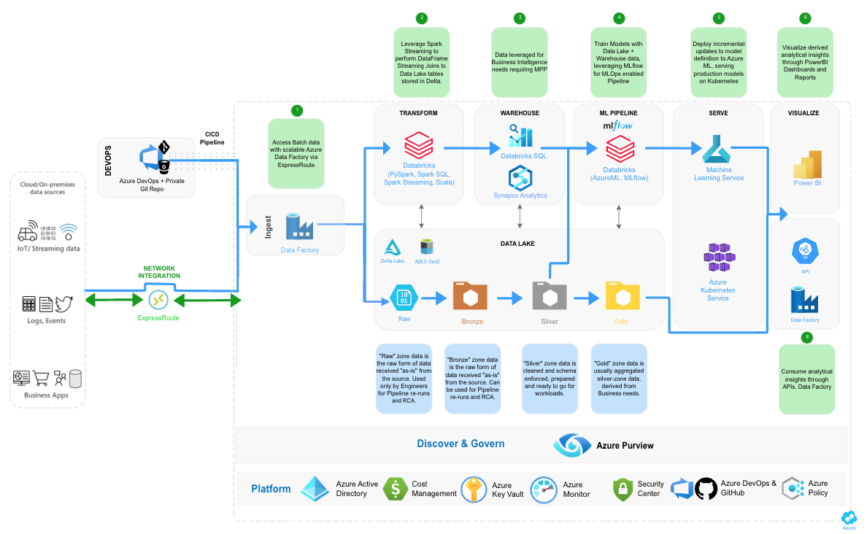
ALMP Data Platform Architecture – Proposed from Microsoft SME

Slide 7
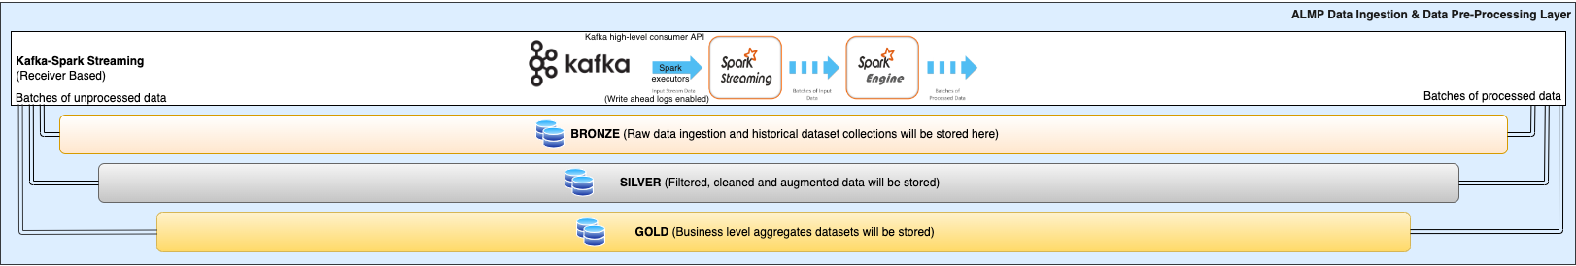
ALMP Data Platform Expansion with Existing Design (Next Phase)

Slide 8
ALMP Infrastructure Design

Slide 9
Americana Last Mile Platform – Infrastructure Design Environments
Cloud design consists of the various cloud resources as part of the ALMP platform design which is managed via below environments
ALMP Platform Users
(Stores, Drivers, Customer, Aggregators, DoD Partners,…)
HUB Subscription – Considered as a DMZ network contains public-facing services and is designed to help protect the internal networks.
Non-Prod Subscription – Contains non-production (Dev/QA/UAT) environment resources
Production Subscription – Comprised of Production environment resources
DR HUB Subscription – Provisioned in a different region it acts as a DMZ (Demilitarized Zone) network for DR resources.
DR Prod Subscription – Acts as a DMZ for DR resources.
Traffic Manager
Routed to DR if Region-1 DC Failed
2. Central Hub Subscription
5. DR Subscription
ALMP Primary Hub
ALMP DR Hub
Region-1
Region-2
1. DEV
4. Pre-Prod
6. Disaster Recovery
2. QA
5. Prod
3. UAT
1. Non-Prod Subscription
3. Production Subscription
4. DR Subscription
DR region will be decided with the prod during the launch at the end of year 2022.
The list of resources which is common for non-prod and prod is in discussion with partner which consists of Firewall, KeyVault and other common cloud services.

Slide 10

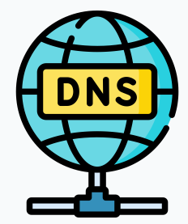
























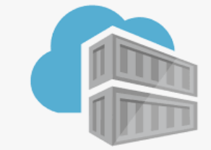



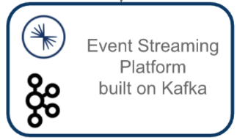

11/01/2023
ALMP Platform – Disaster Recovery Challenges
almp.americana.rest
HD Stores/
Fleet Controllers
Rider / Driver
Azure Traffic Manager
Primary region UAE North
DR region North Europe
Prod- HUB
Azure policies
Azure Firewall (HA)
UI Web VM
Azure Firewall (HA)
API
Management
Monitor
App Gateway + WAF
UI Web VM
API Management
App Gateway + WAF
vnet peering
vnet peering
Prod- Spoke
App insights
PSQL Replication
Log analytics
AKS (HA)
Storage
Account
AKS (HA)
PSQL
Redis
cache
PSQL
(Read Replica)
Storage
Account
KV
Redis
cache
KV
ACR
ACR
Azure defender
Inbound traffic from internet controlled via WAF
Outbound traffic to internet from the resource controller via Firewall

Slide 11
ALMP Scale Up Challenges

Slide 12
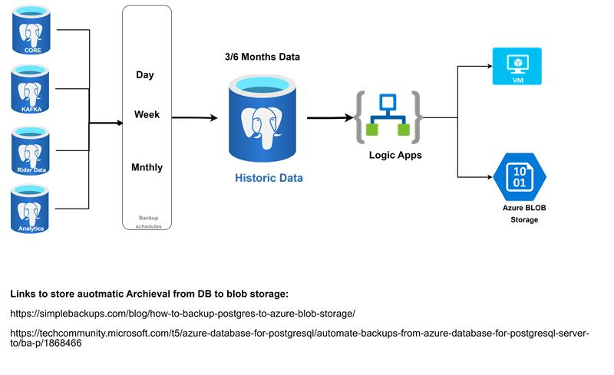
New Proposed Approach By Development Partner (Cognizant)

Slide 13
Temp Approach to Agreed with Development Partner

Slide 14
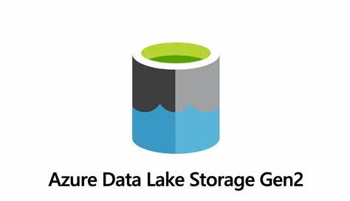

New Approach – In Discussion with Development Partner
X

Slide 15
Final Approach – Recommended from Americana

Slide 16


